Slide 1


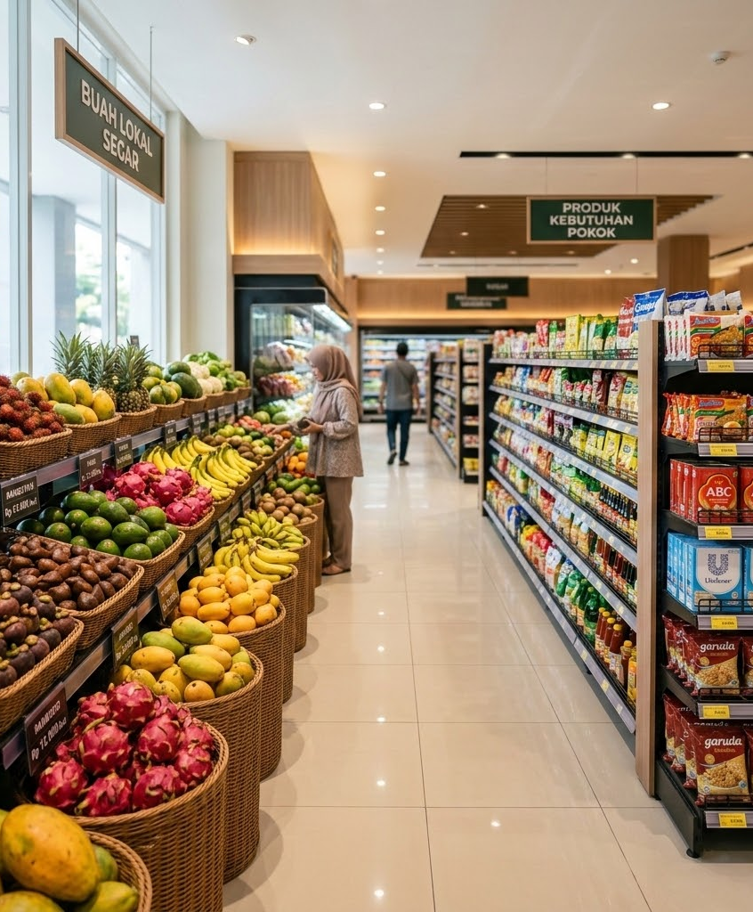
Market Analysis
Indonesian
Supermarket
Business

Slide 2
Background & Objective
historyBackground
The company needs a clear overview of its sales performance from 2014 to 2017 across time, regions, product categories, cities, and shipping methods.
trending_upObjective
To identify sales trends, regional and category contributions, the highest-performing city and month, and the most frequently used shipping method.

Slide 3

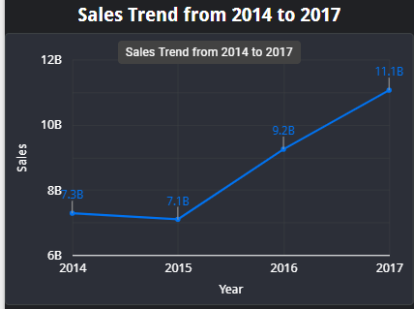
What was the trend in sales value from 2014 to 2017?
trending_upConsistent Growth Trend
+52%Overall Sales Increase
Initial Dip (2014-2015): Sales started at 7.3B in 2014, experiencing a minor decline to 7.1B in 2015.
Strong Recovery (2016): Sales rebounded sharply to 9.2B, showing a robust upward trajectory.
Peak Performance (2017): Reached an all-time high of 11.1B, confirming strong market expansion.

Slide 4
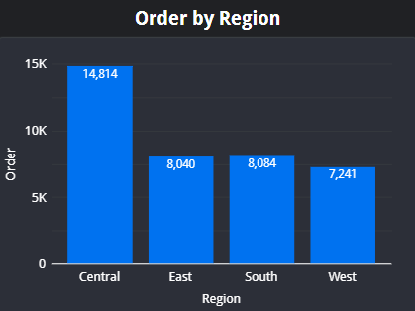
What was the proportion of orders by region?
roomRegional Order Distribution
East & West
Drive Over 60% of Total Orders
East Region Leads: Generates the highest proportion of supermarket orders.
West Region: Follows closely as the second-largest contributor to sales volume.
Central & South: Represent smaller, developing markets with high growth potential.

Slide 5
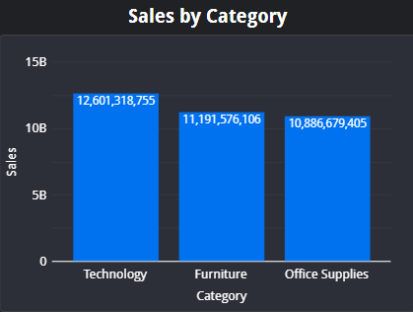
What was the sales proportion for each product category?
shopping_bagProduct Category Sales
Technology Leads
With Over 12.6B in Total Sales
Technology: Highest contributor with 12.6B, driven by high-value accessories.
Furniture: Strong performance at 11.2B, showing consistent customer demand.
Office Supplies: Close third at 10.9B, representing high-volume essential orders.

Slide 6
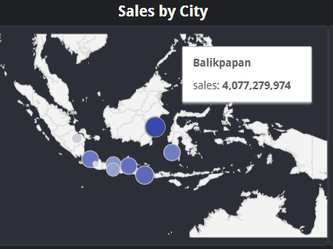
Which city generated the highest sales?
place City Sales Performance
Balikpapan Leads
With Around Rp4.1 Billion in Total Sales
Penjualan Tertinggi: Kota Balikpapan menghasilkan nilai penjualan tertinggi.
Dominasi Pasar: Mengungguli performa kota-kota lainnya secara signifikan.

Slide 7

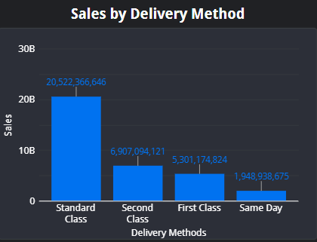
Which shipping method was most frequently used by buyers?
local_shippingShipping Method Preference
Standard Class
Dominates with Over 20.5B in Sales
Standard Class: Highly preferred choice, representing the vast majority of orders.
Second & First Class: Moderate usage, offering a reliable balance of cost and delivery speed.
Same Day: Lowest frequency, typically selected only for urgent delivery requirements.

Slide 8
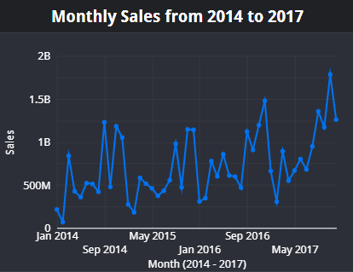
Which month saw the highest sales between 2014 and 2017?
trending_up Sales Trend Analysis
November 2017
Puncak Penjualan Tertinggi Sekitar Rp1,8 Miliar
Penjualan Tertinggi: Terjadi pada bulan November 2017 dengan nilai mencapai sekitar Rp1,8 miliar.
Tren Pertumbuhan: Menunjukkan fluktuasi musiman dengan kecenderungan meningkat signifikan menjelang akhir periode 2017.

Slide 9
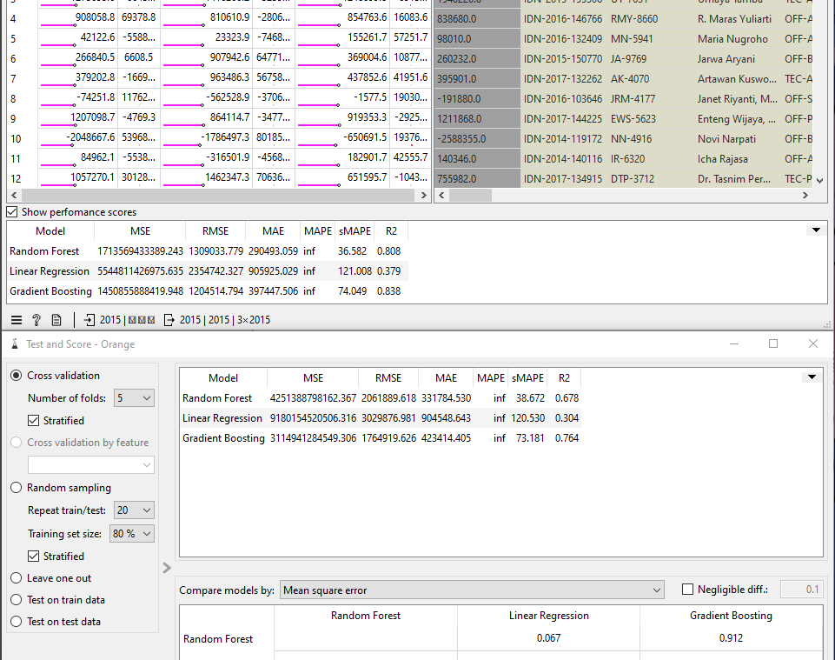
What is the estimated profit from the store's sales?
insights Model Performance Analysis
Gradient Boosting Wins
Selected as Primary Model with 0.838 R²
Best Predictor: Achieved lowest RMSE of IDR 1.20 million on holdout test data.
High Accuracy: Explains 83.8% of profit variation, beating Random Forest and Linear Regression.
Underprediction: Estimated profit of IDR 819.20M vs. actual IDR 888.81M (7.83% error).

Slide 10
Conclusion & Recommendation
lightbulbKey Conclusions
Tech & Balikpapan Drive Growth
Technology Dominance: Technology leads category sales with 12.6B, followed closely by furniture.
Regional Stronghold: Balikpapan emerges as the primary driver of regional sales performance.
Standard Shipping: Standard Class remains the most preferred shipment choice for buyers.
starStrategic Recommendations
Target Regional Tech Buyers
Optimize Product Mix: Increase high-value accessory inventory in Tech to boost average order value.
Balikpapan Expansion: Launch hyper-local marketing and build partnerships in high-performing regions.
Seasonal Campaigning: Allocate promotional budgets heavily toward the peak November sales trend.

